Slide 1
PFB2023 Final Project
Proposal: Build a FASTA tool
Shreya, Ayushman, Thompson, Camila, Gabriel
TA: Eric

Slide 2
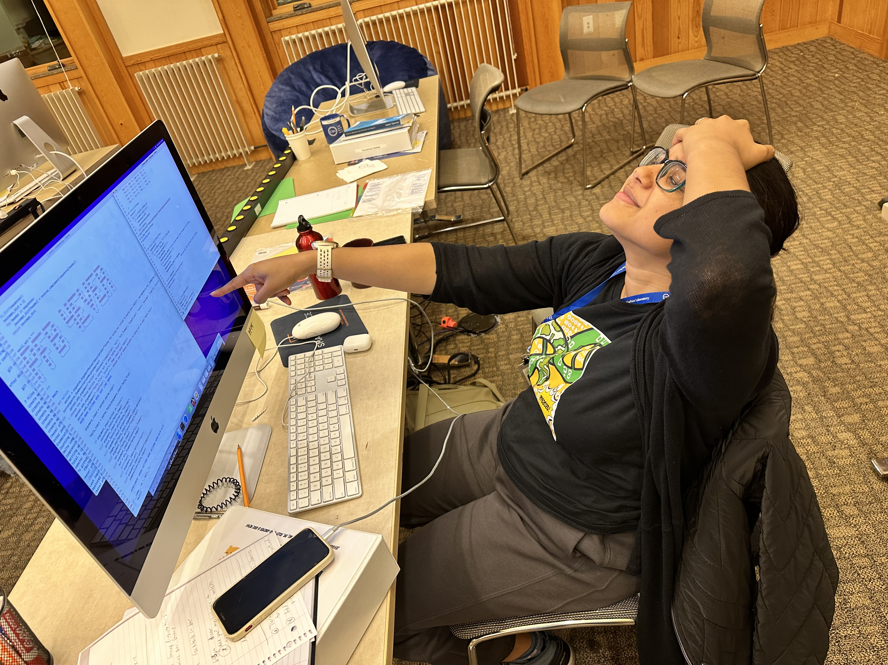
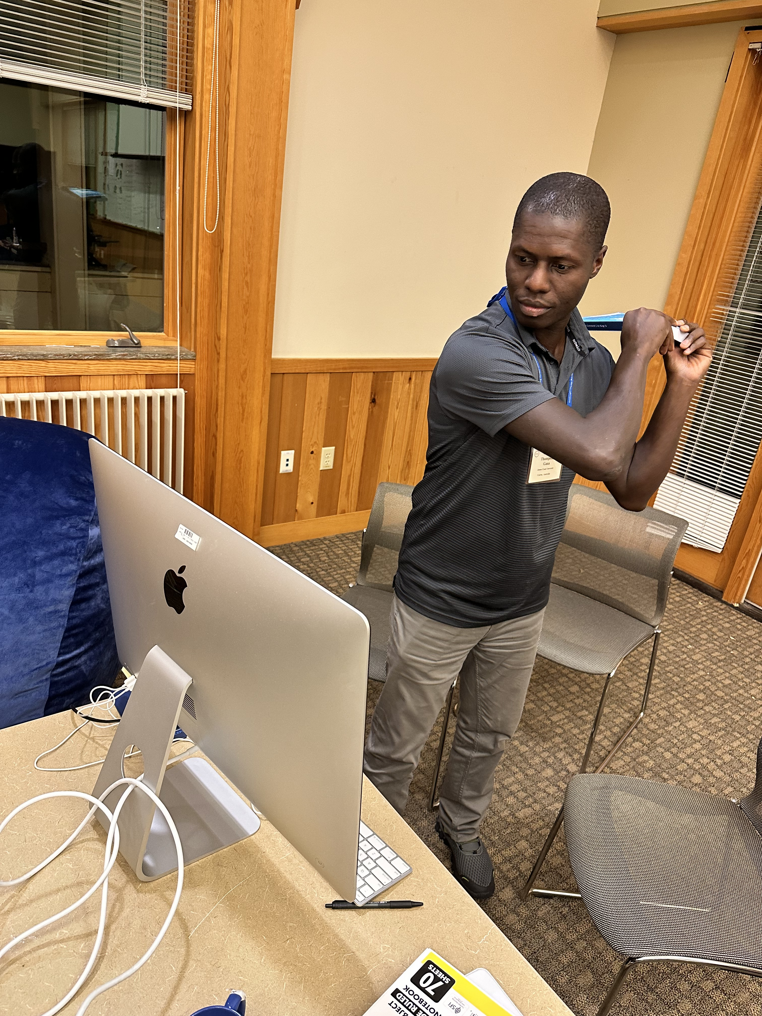
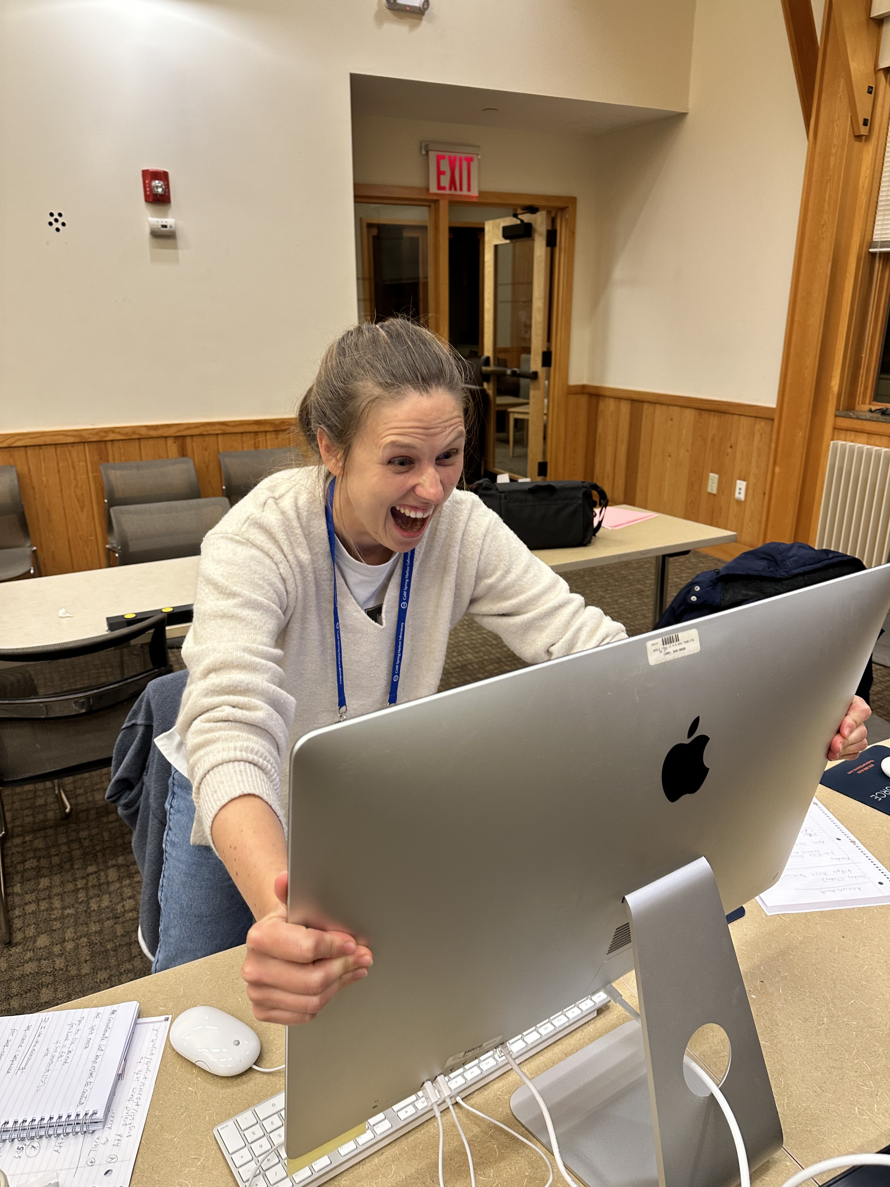
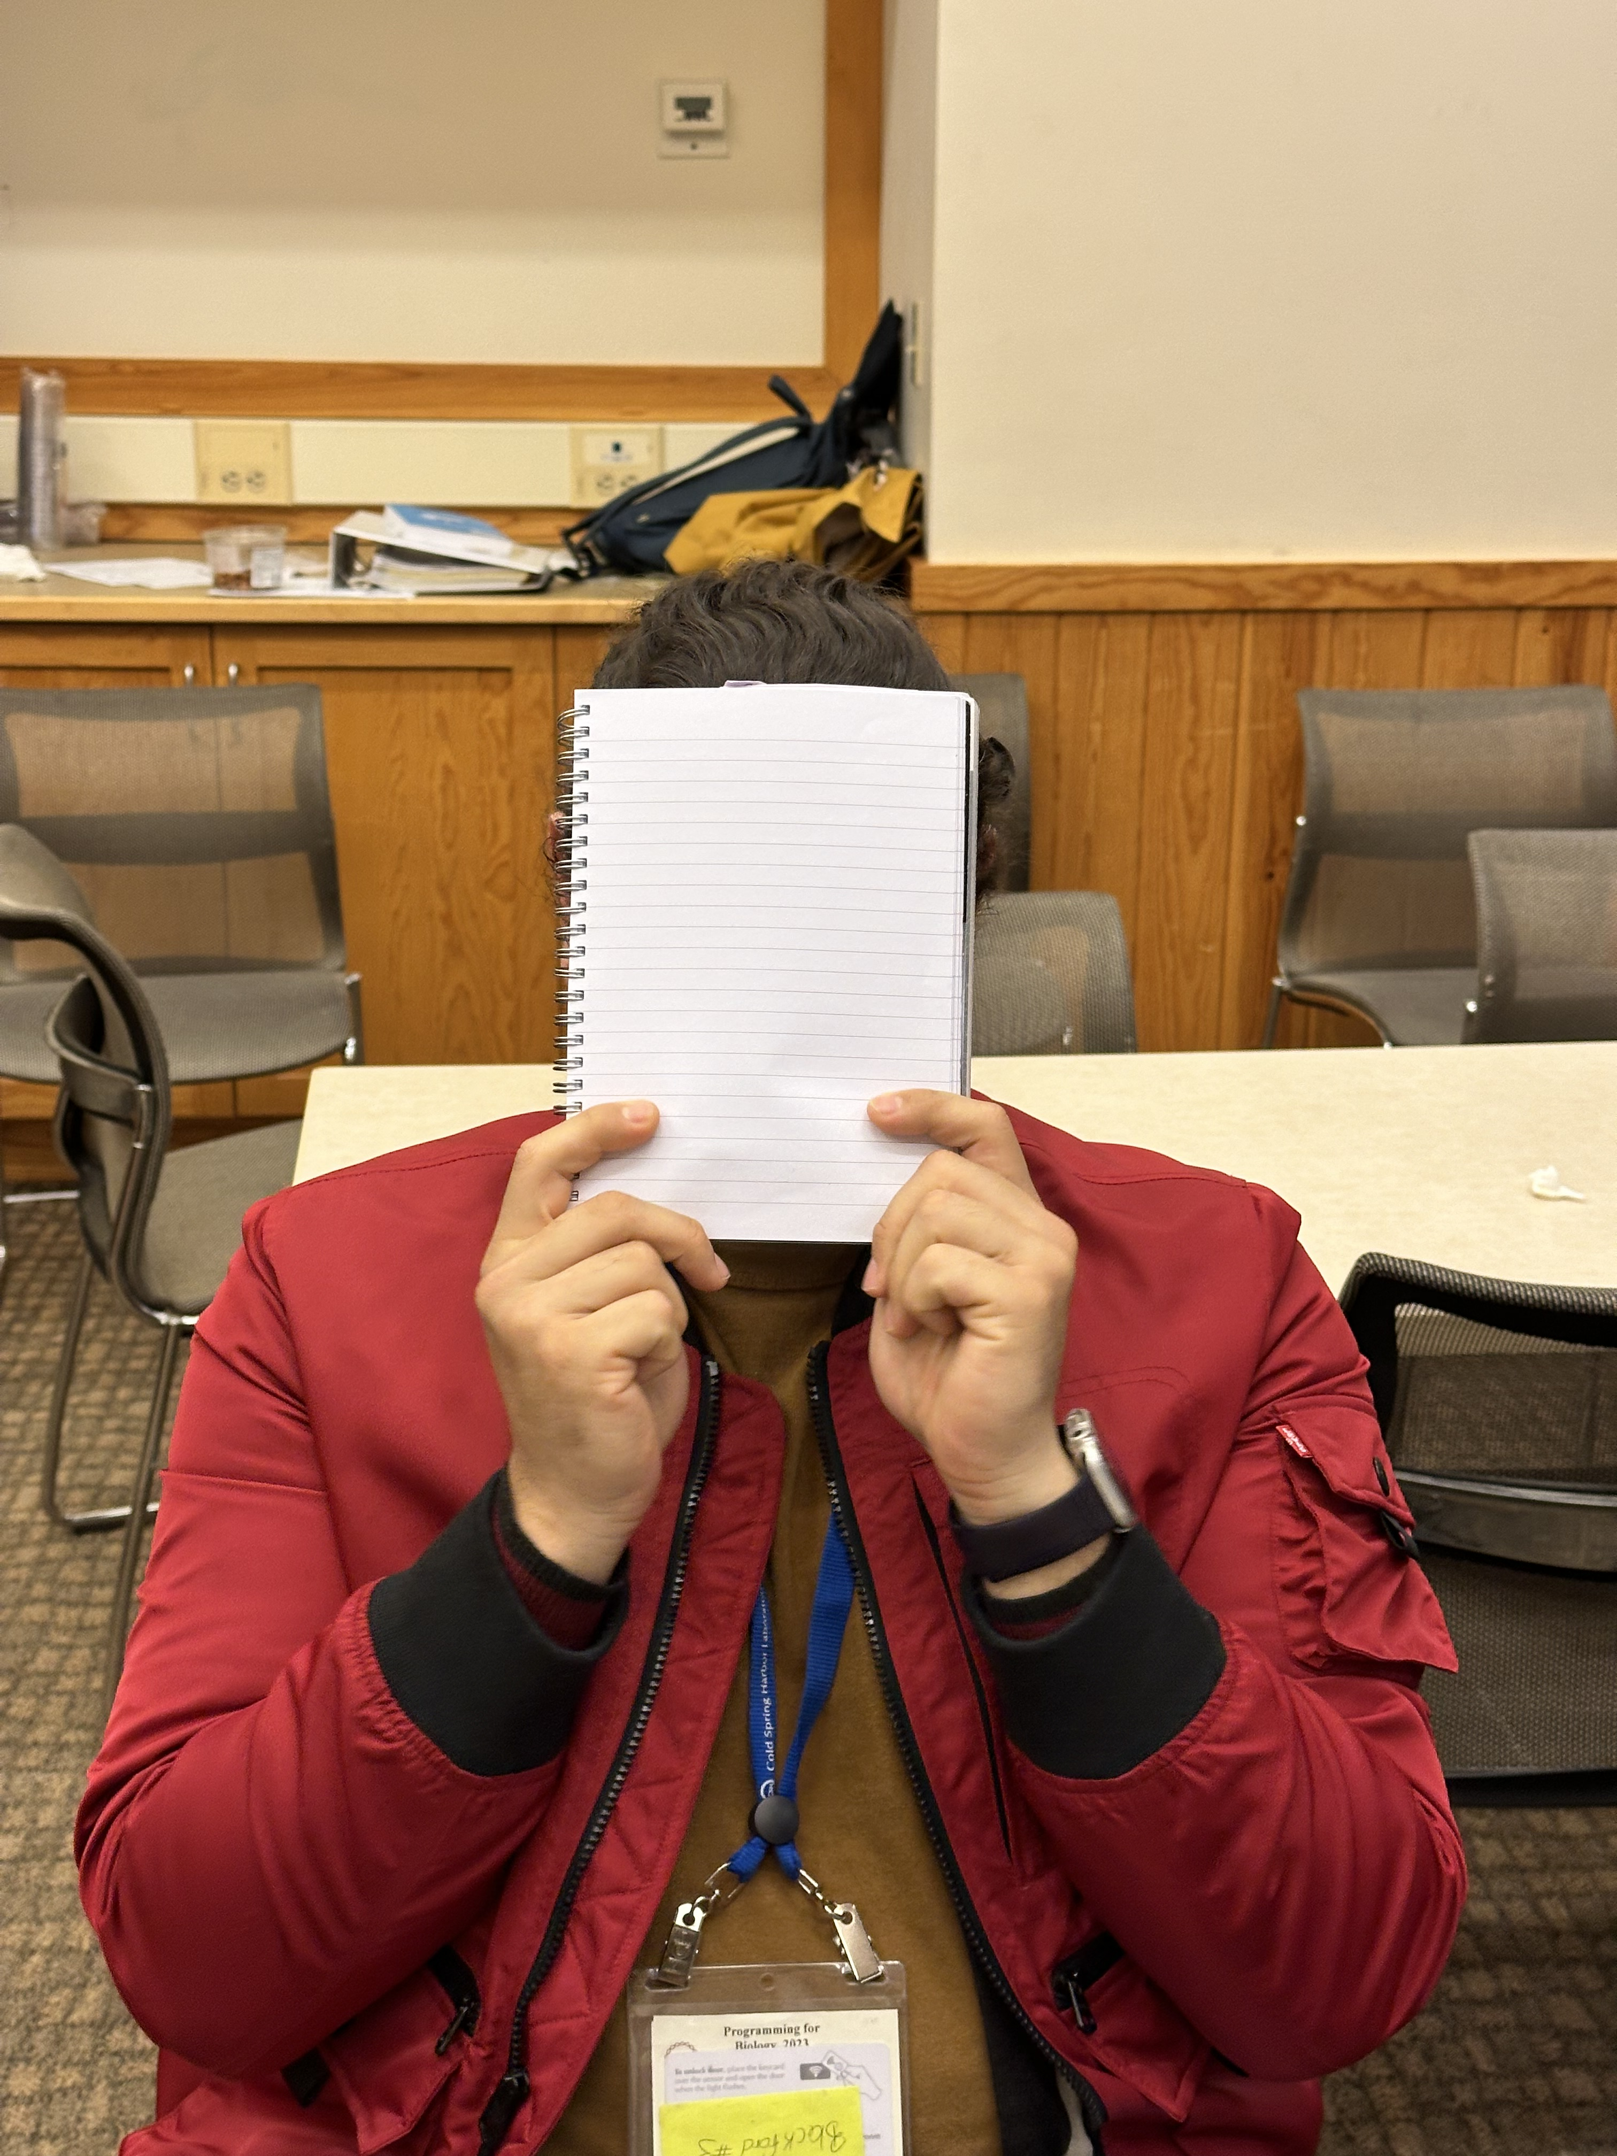
Tired of writing in each function you need?
Tired of debbuging?
Done with searching for scripts on internet?
Needing the hours for enjoying the sun and not coding all day?

Slide 3
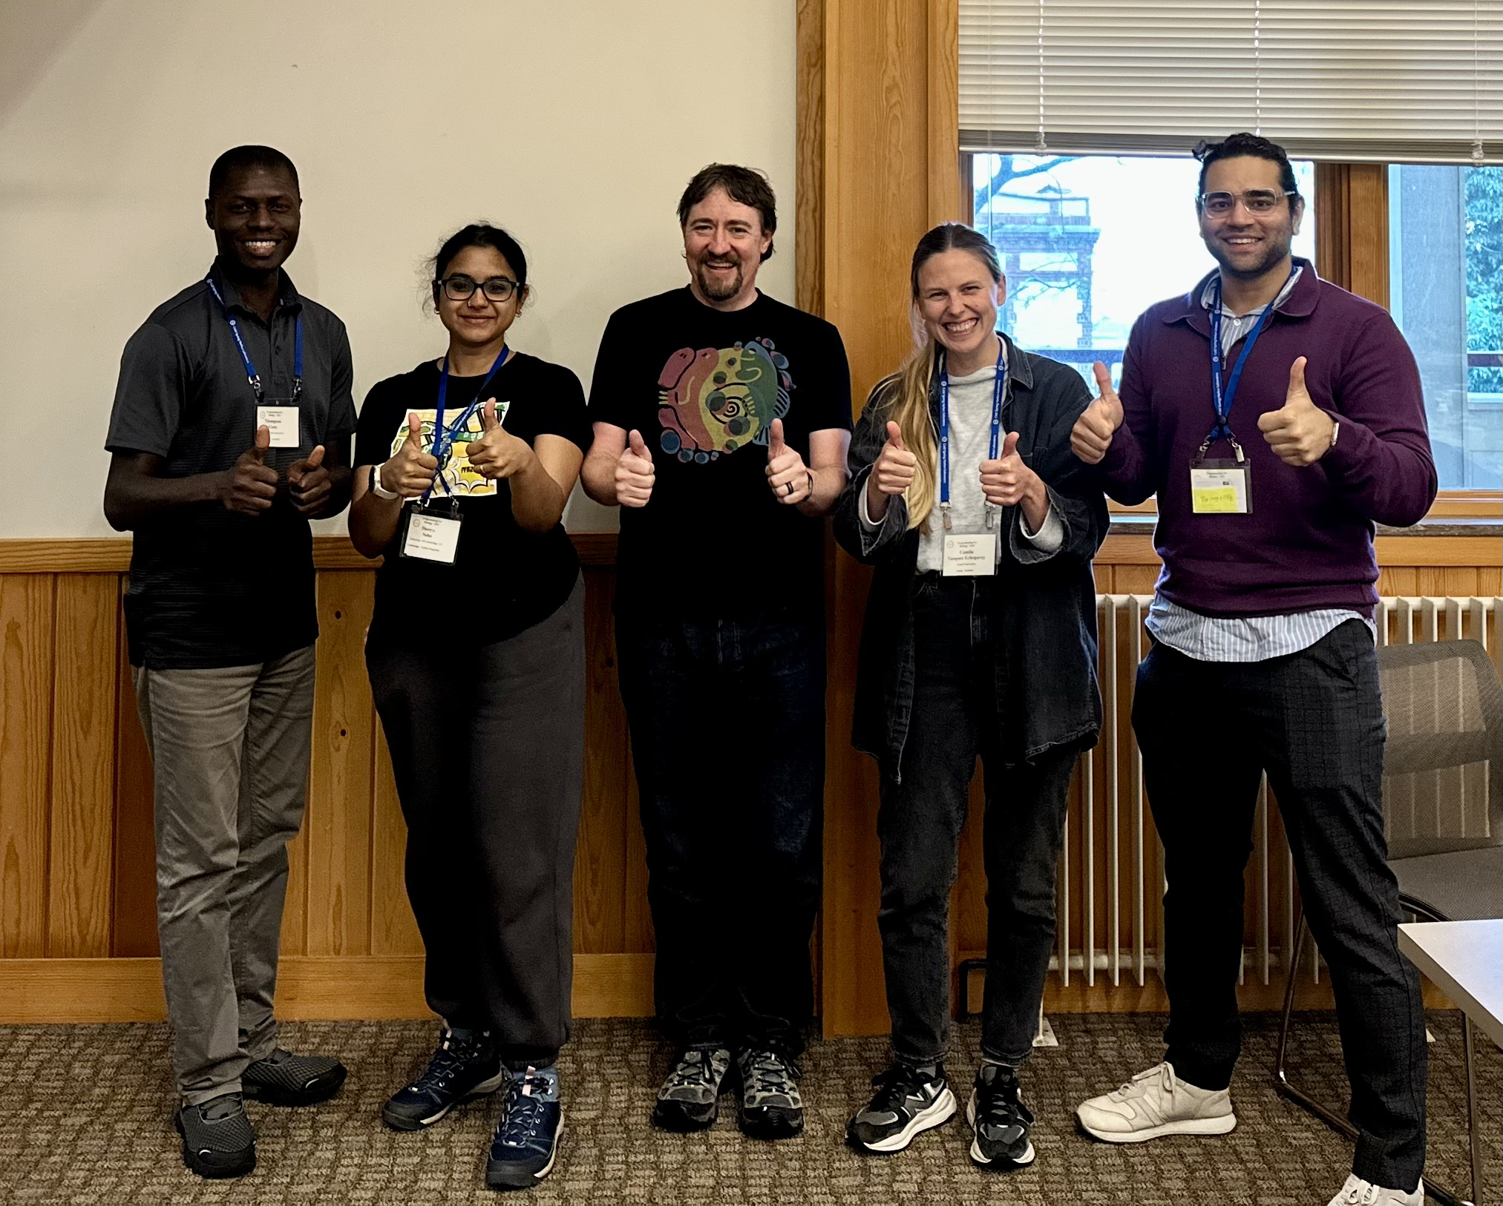

Slide 4
BETTA
STRONGA
FASTA

Slide 5
All-in-one script
…with more than 10 functions!!!
Parse from a FASTA file
parse_fasta(saves dict): nt/protein fasta
Prints back parsed FASTA file
print_fasta(print to screen): nt/protein fasta
Collects some statistics from FASTA file
stats(print to screen): nt/protein fasta
Gives back the GC content (%)
GC_content (print to screen) – nt fasta
Plots the GC content
GC_histo(saved png) – nt fasta (large file)
Gives the composition (%) of each nt or aa
composition(print to screen): nt/protein fasta
Splits FASTA file into individual n files(n=number of seqs in the FASTA)
split_dict(saved to .fasta) – nt/protein fasta
Collects all sequences names
seq_ids(saved to txt) – nt/protein fasta
Probability of finding a nt or an AA at a site in an alignment
logo(saved png) – alignment nt/AA
Finds motifs/patterns in a FASTA file
regex(print to screen), choose --pattern: nt/protein fasta
Graphical representation seq lengths in a FASTA file
len_bars(saved png): protein fasta
Reverse comp all seqs in FASTA file
revcomp(print to screen): nt fasta
Making 3 forward and 3 reverse ORFs
six_frames(print to screen): small nt fasta
Saves to a file all possible CDS
all_CDs(save to file in command) – nt fasta
Gives longest peptide per sequence
longest_peptide(print to screen) – nt fasta
Notes:
print_fasta", "all_CDs", "longest_peptide", "logo", "seq_ids", "split_dict", "split", "composition ", "art", "six_frames", "length_bar", "stats", "revcomp", "regex", "GC_content","GC_histo"

